Slide 1

F1nance
TEAM 2

Slide 2
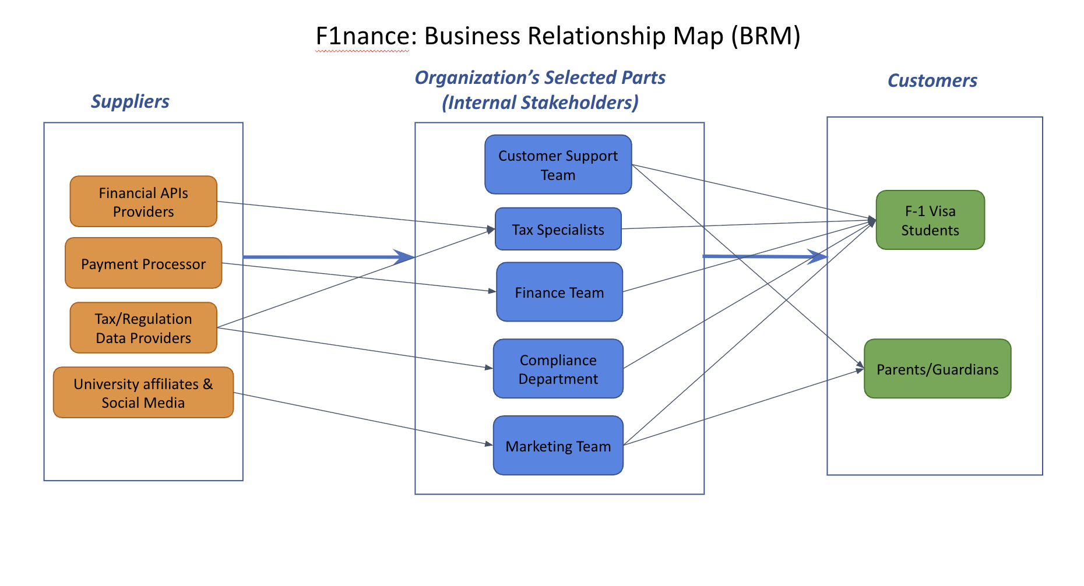
BRM Diagram (Presented by Venkata)

Slide 3
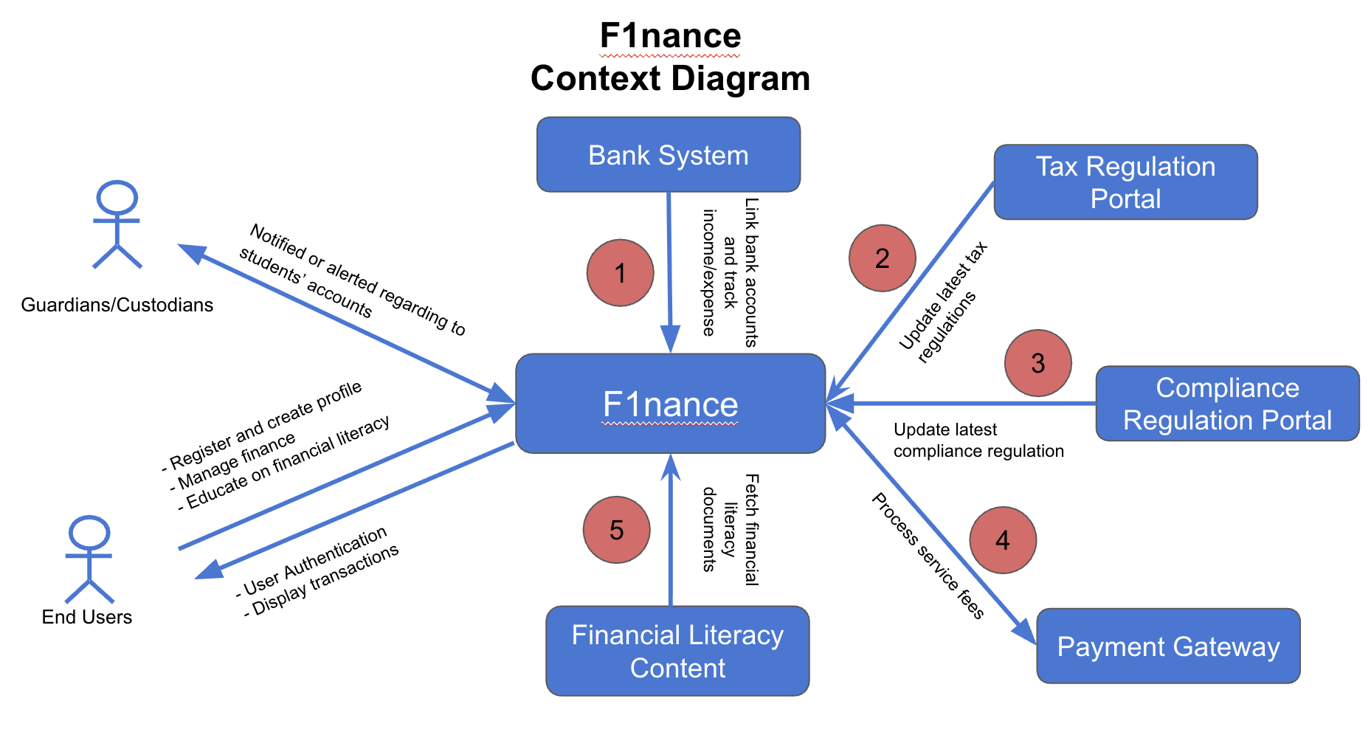
Context Diagram (Presented by Vinay)

Slide 4
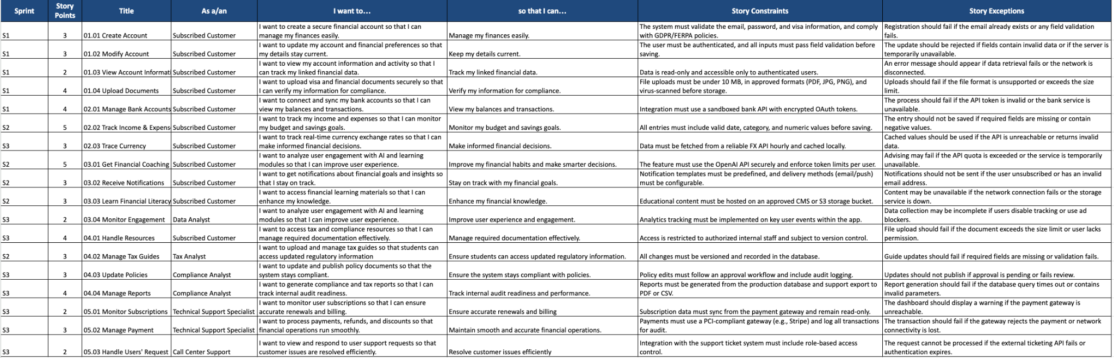
User Stories (Presented by Shivani)

Slide 5
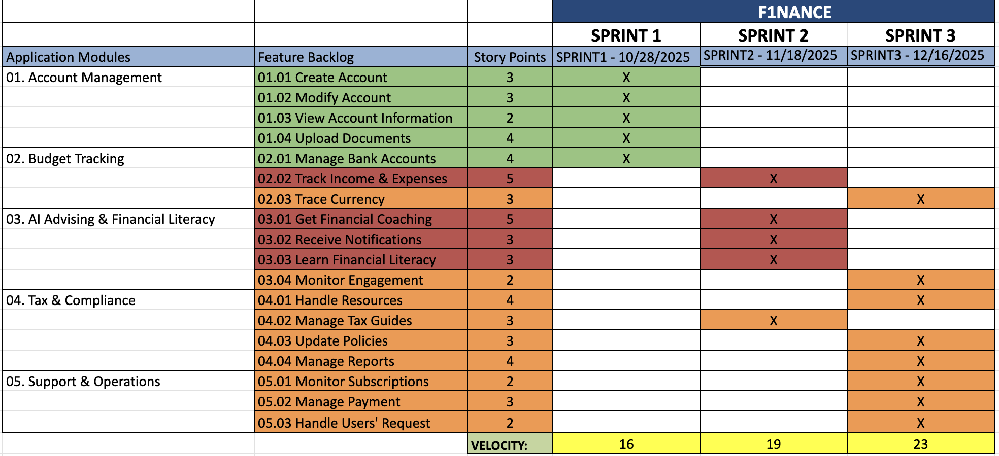
Road Map (Presented by Mounika)

Slide 6
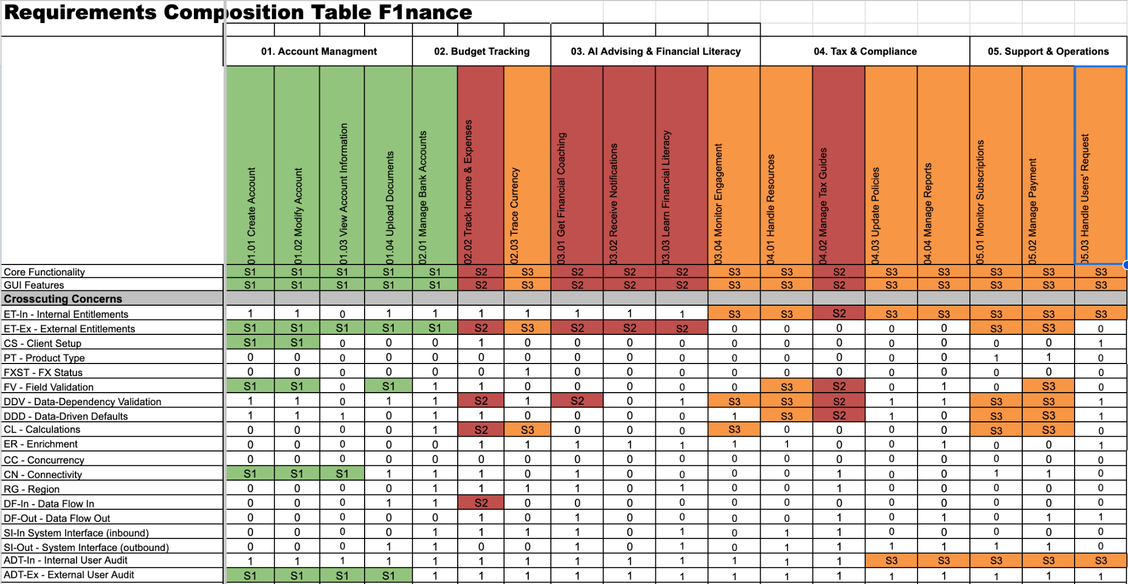
RCT (Presented by Kavya)

Slide 7
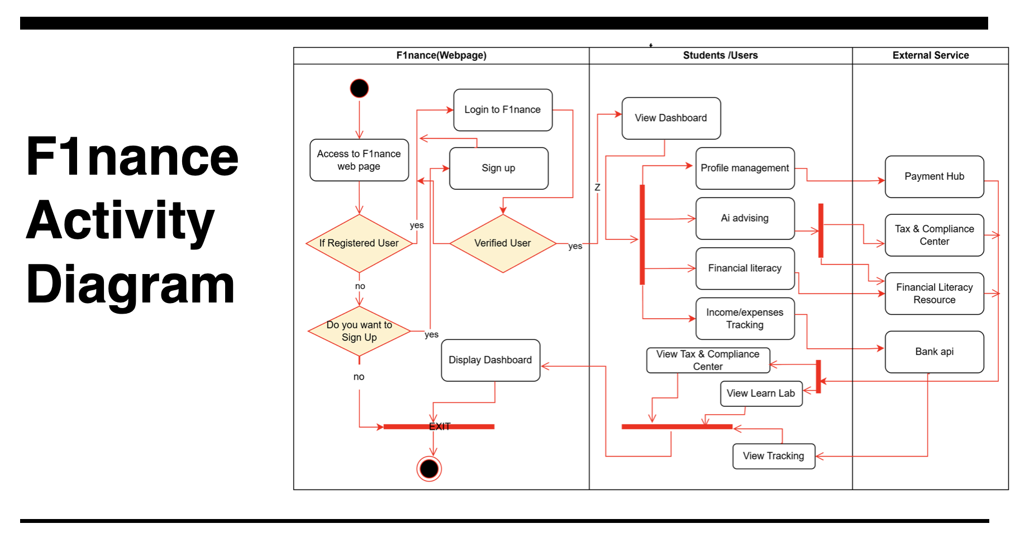
Activity Diagram (Presented by Vinh)

Slide 8
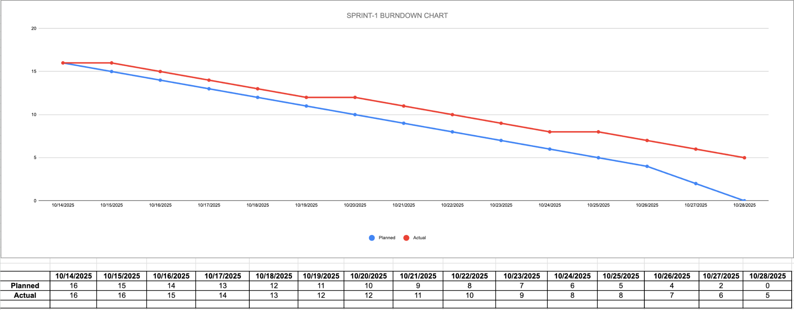
Burndown Charts (Presented by Aasmeen)

Slide 9
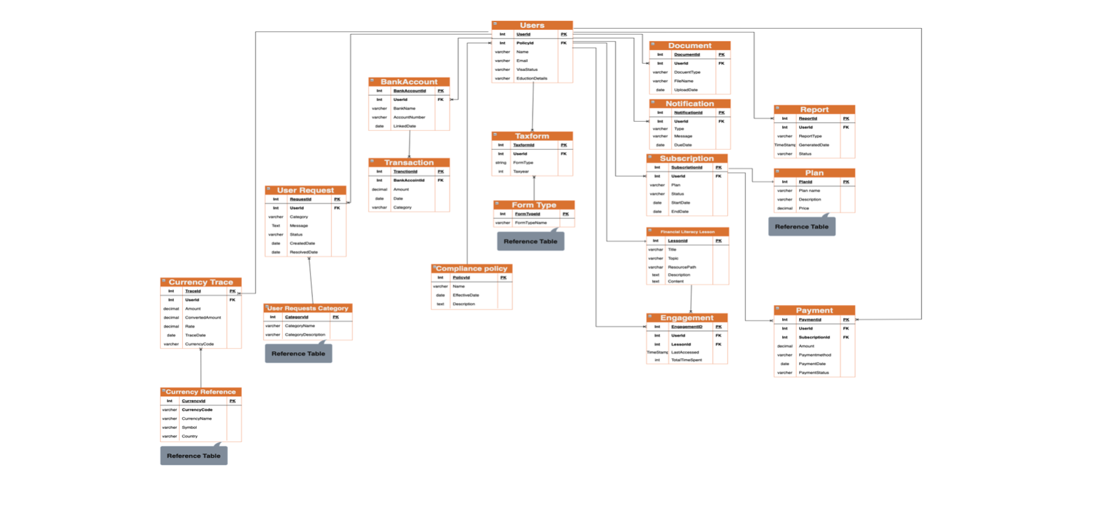
ER Diagram (Presented by Deep)

Slide 10
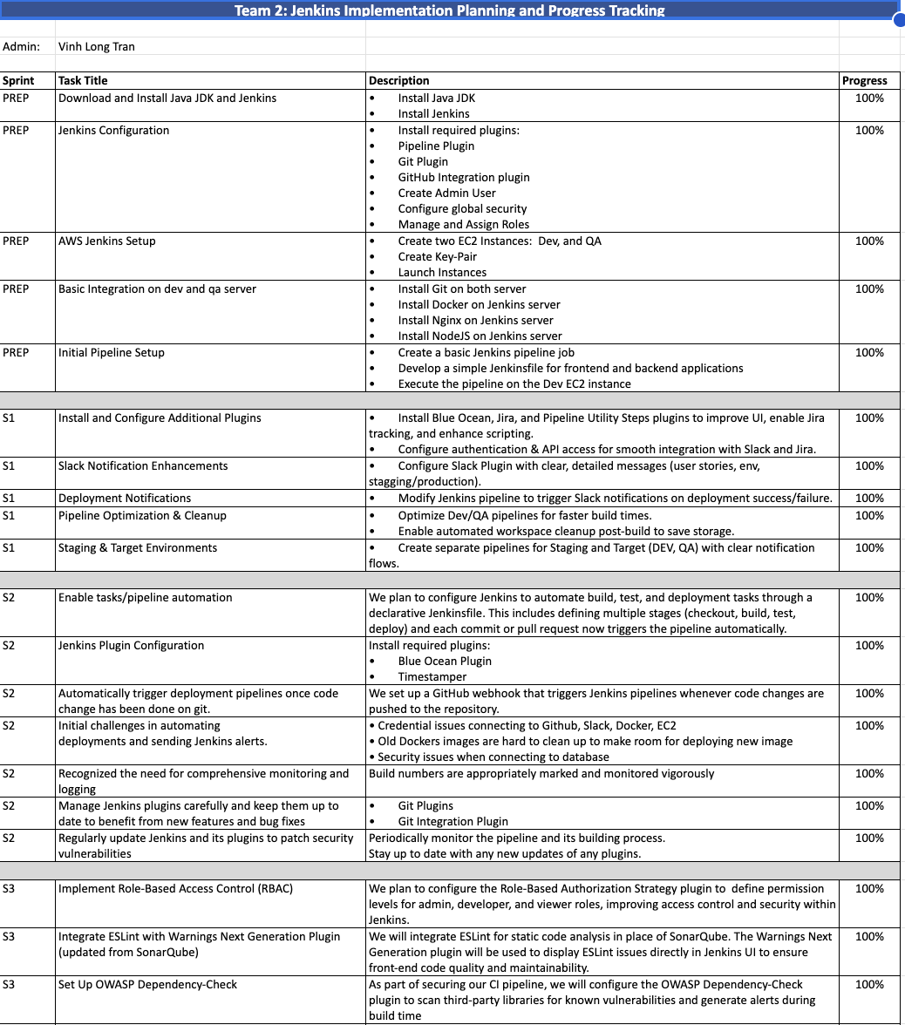
Jenkins (Presented by Vinh)

Slide 11
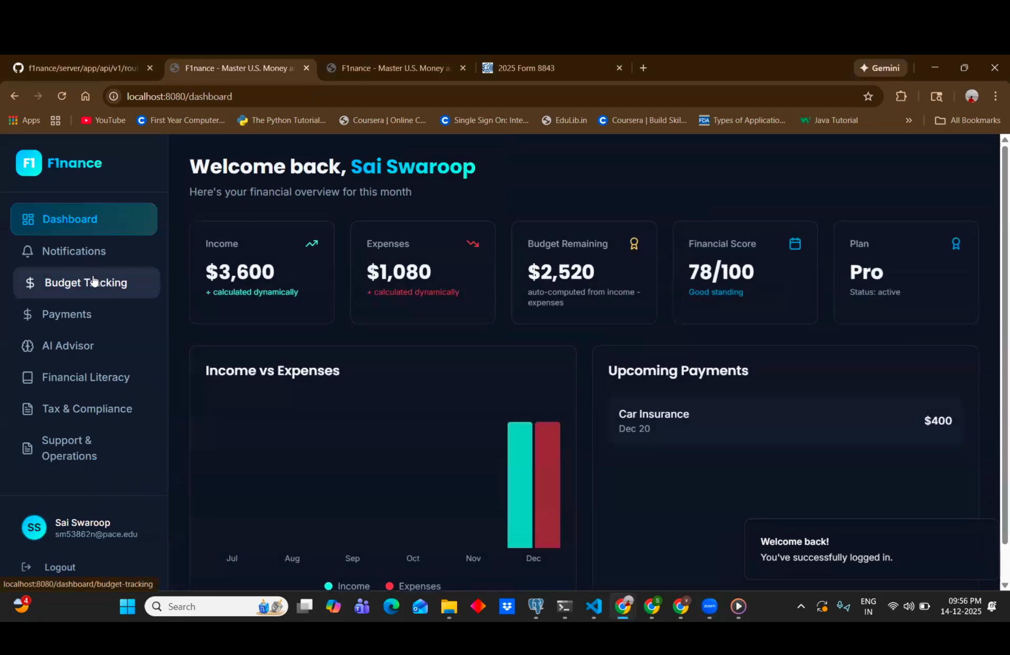
App Demo (Presented by Sai Swaroop, Sai Gnandeep)

